Slide 1
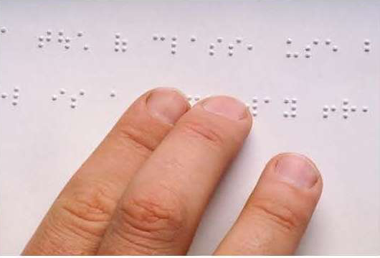
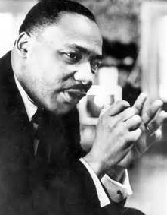
January is Braille
Literacy Month.
Braille is a system of
raised dots that
made it possible for
people who are
blind to read and write for
themselves.
January is the month of Martin Luther King Junior’s birthday, a time when we celebrate and recognize the impact that MLK had on our society and civil rights in America.

Slide 2
Why is Stevie Wonder the musician of the month??

Slide 3
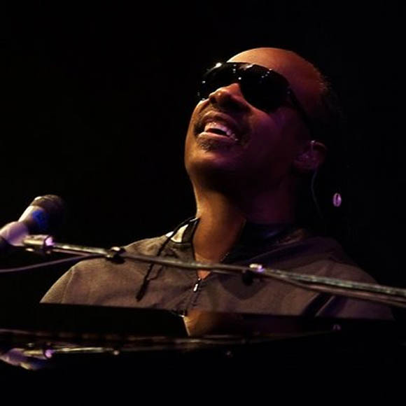
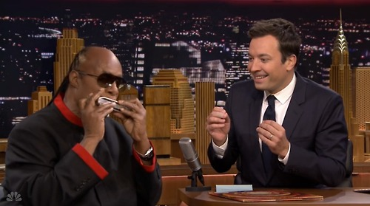
Stevie Wonder is an American musician, singer, songwriter, record producer and instrumentalist. He was born in Michigan, and was one of 6 children in his family.
Doctors discovered he was blind while in the hospital after his birth. Stevie was born 6 weeks premature (early).

Slide 4
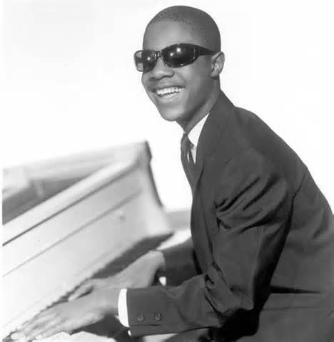
Not only was Stevie Wonder an outstanding singer, but by the age of 9, learned to play the drums, piano and the harmonica.
Stevie’s first nickname was “Little Stevie Wonder” when he was signed by his first record label at age 11. While singing and performing, Stevie was taught by a private tutor, since he didn’t go to school at that time.

Slide 5
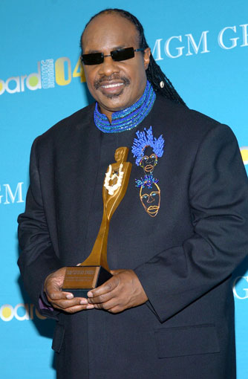
Stevie wonder has won 25 Grammy Awards, was inducted into the Songwriters and Rock and Roll halls of fame, received a Lifetime Achievement Award from the National Civil Rights Museum, was named one of the United Nations Messengers of Peace, and earned a Presidential Medal of Freedom from President Barack Obama in 2014.

Slide 6
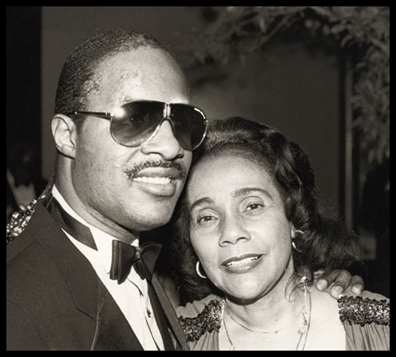
Stevie Wonder's song "Happy Birthday” was written in 1981 as part of the campaign to have the birthday of Martin Luther King, Jr. become a national holiday. The lyrics express his appreciation of MLK and his impact.
"I just never understood, how a man who died for good, could not have a day that would be set aside for his recognition," he sings.

