Slide 1
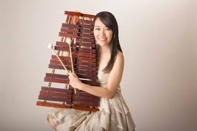
Mika Mimura

Slide 2
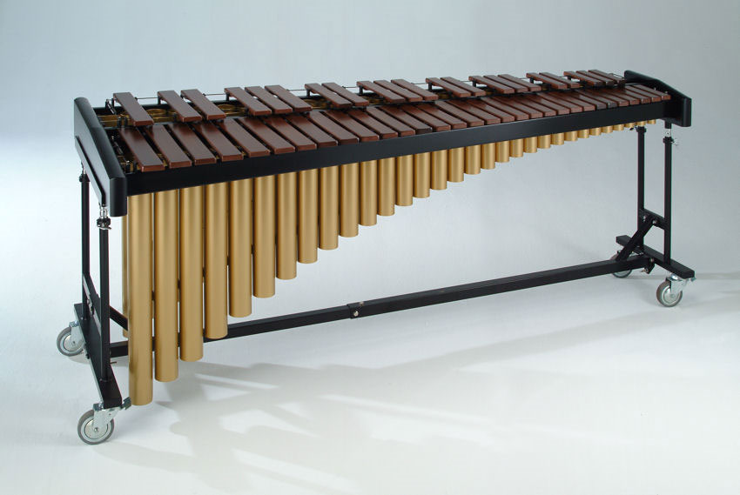
Mika Mimura was born in Osaka, Japan where she began playing piano at the age of 3. At 6 years old she took up marimba.
The marimba is a percussion instrument similar to the xylophone, with wooden bars. However, a marimba is larger, and has tubes, or “resonators” to enhance and amplify the sound

Slide 3
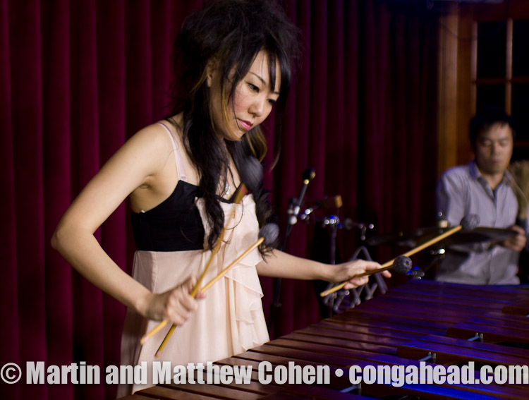
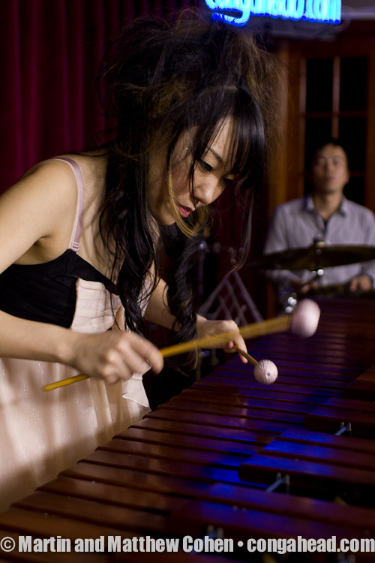
Mika attended college at the Osaka College of Music in Japan, but later traveled to America to attend the Berklee College of Music, in Boston Massachusetts.

Slide 4
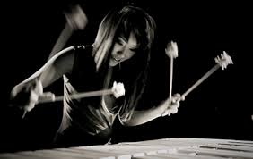
After finishing Berklee, Mika moved to New York, where she has been steady at work composing music and teaching while performing her music in and around NY in addition to touring Europe, North America, South and Central America.

